Slide 1
Credit Card Fraud Detection
Hemachandar Nagarajan

Slide 2
Business Problem
Our business problem is to accurately identify fraudulent credit card transactions.
This is an important issue as:
The global credit card fraud volume was $24 billion in 2018.
It’s growing by over 10% a year.
Fraud is becoming more sophisticated.
It impacts how much customers trust financial institutions and merchants.

Slide 3
Implications
While consumers are shielded from having to pay for fraudulent transactions, financial institutions and merchants are responsible for covering the cost of the fraudulent transactions.
Generally, financial institutions are responsible for fraud on in-store transactions and merchants are responsible for fraud committed in online transactions.
Improvement in fraud detection can save financial institutions and merchants millions of dollars in cost annually.

Slide 4
Dataset Description
https://www.kaggle.com/mlg-ulb/creditcardfraud
Data Source (Link)
The dataset consists of transactions made by European cardholders in September 2013 over a 2-day window.
The dataset is highly imbalanced. There are 492 frauds out of 284,807 transactions.
Variables
There are 31 variables.
The time, amount and class of transaction (1 = fraud, 0 = legitimate transaction).
There are 28 other variables which are the result of PCA transformation on the original data. We have no information about what the original variables were.

Slide 5
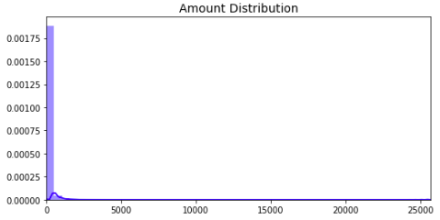
Non-PCA Variable Analysis
Amount The distribution of amount is highly left-skewed. 80% of the transactions are below 100 euros.

Slide 6
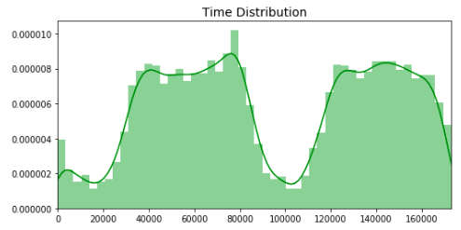
Non-PCA Variable Analysis
Time The time variable seems to be capturing the time in seconds since the first entry in the database. There appears to be a daily cyclicity in the data according to the transaction distribution.

Slide 7
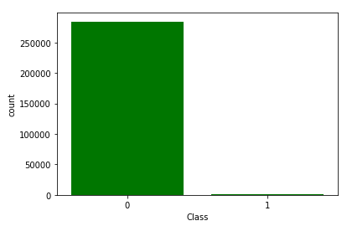
Non-PCA Variable Analysis
Class The class variable captures if a particular transaction is classified as fraud or not. It is highly imbalanced. There are 492 frauds out of 284,807 transactions.

Slide 8
PCA Generated Variables
The 28 variables generated using Principal Component Analysis (V1 to V28) have a mean of zero as expected.
Most of the values for these variables lie within one standard deviation of the mean.

Slide 9
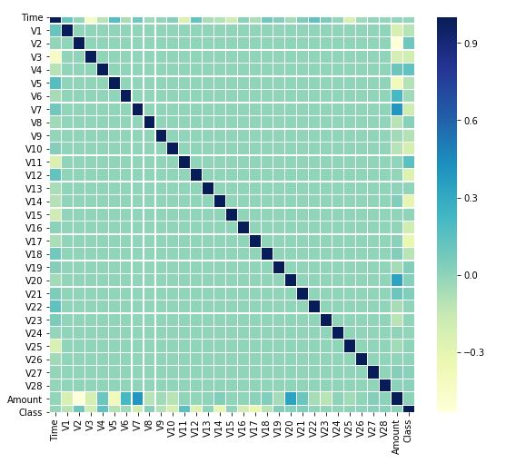
Correlation
PCA converts the original data into dimensions which have no correlation.
As a result there is no correlation between most variables.
The plot displays the correlation for variable pairs which have a correlation magnitude greater than 0.10.
Some the PC variables are correlated to time, amount and the class variable.
The maximum correlation is between V2 and Time (-0.40).

Slide 10
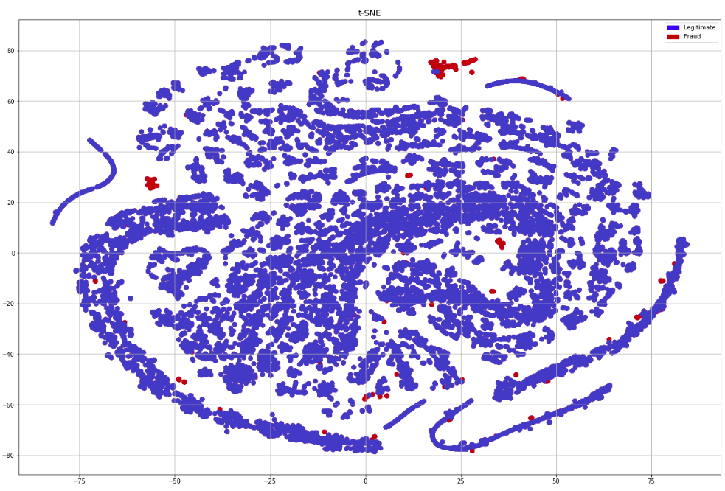
t-Distributed Stochastic Neighbor Embedding
t-Distributed Stochastic Neighbor Embedding reveals the structure of the data on a single map.
The map plots 41 fraud cases and 28508 legitimate transactions.
It suggests that a lot of the fraud transactions are well-separated from the legitimate ones.
There are multiple clusters of fraud possibly indicating different patterns of fraud.

Slide 11
Model Performance - Data
To measure model performance we’ve split the data into two chunks.
70% for Training the model
30% for Testing our model

Slide 12
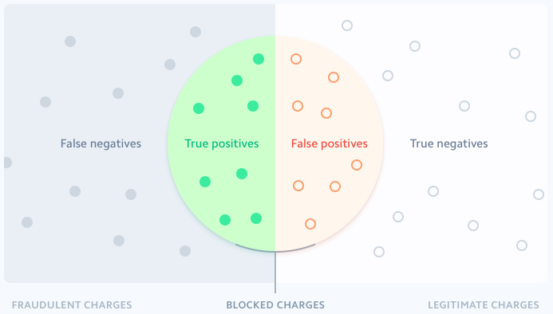
Model Performance - Terms
The image shows how model predictions are classified.
False Negative and True Positives are fraudulent transactions.
False Positives and True Negatives are legitimate transactions.
True Positives and False Positives are the transactions identified as fraud by the model.

Slide 13
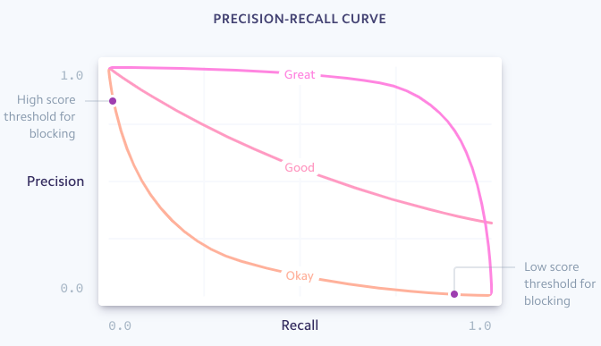
Model Performance - Metrics
As our dataset is imbalanced, we’ve identified the following metrics to measure model performance.
Precision Fraction of transactions the model classifies as fraud that are actually fraudulent. Precision = TP / (TP + FP)
Recall Fraction of all fraud that is identify by our model. Recall = TP / (TP + FN)
F-Measure A good measure to use when we seek a balance between precision and recall and the there is an uneven class distribution. F-Measure = 2 * Precision * Recall / (Precision + Recall)

Slide 14
Decision Tree Classification

Slide 15
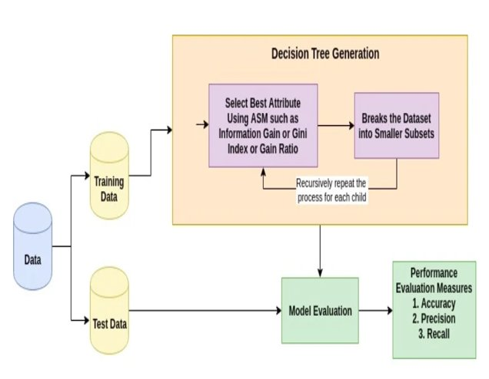
DT – Method
Decision tree builds classification or regression models in the form of a tree structure.
It breaks down data set into smaller and smaller subsets while at the same time an associated decision tree is incrementally developed.
The final result is a tree with decision nodes and leaf nodes. A decision node has two or more branches.

Slide 16
DT – Feature Selection
For decision trees, feature selection is generally not that important.
During the induction of decision trees, the optimal feature is selected to split the data based on metrics like information gain, so if you have some non-informative features, they simply won't be selected.
Feature selection can still be important for small datasets, where spurious relationships between features and class labels are more commonly seen. This is not an issue for our dataset, so we have not eliminated any variables.

Slide 17
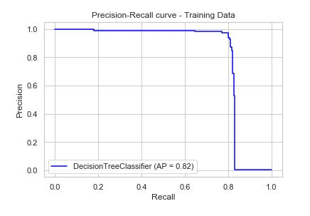
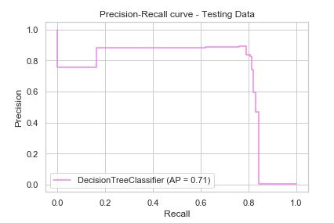
Model Performance
The performance metrics of Decision Tree for the training and test dataset are as follows.
The charts to the right to the show the Precision-Recall curve for the training and test data.
Model performance is quite different for the training and test data.
The average precision is 11% lower for the test data versus the training data.
This suggests that the model has overfit the data.
DT | Training | Test
Precision | 0.97 | 0.83
Recall | 0.79 | 0.79
F-Measure | 0.87 | 0.81

Slide 18
DT – Pros and Cons
Pros
Easy to interpret and visualize.
Can capture non-linear patterns.
No assumptions about distribution because of the non-parametric nature of the algorithm
Cons
Sensitive to noisy data which can lead to overfitting.
A small variance in data can result in a very different decision tree.

Slide 19
Logistic Regression

Slide 20
LR – Method
Logistic Regression is one of the simplest and commonly used machine learning algorithms for two-class classification.
It is easy to implement and can be used as the baseline for any binary classification problem.
Logistic regression describes and estimates the relationship between one dependent binary variable and independent variables.

Slide 21
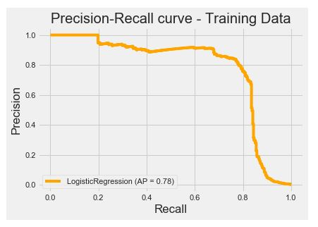
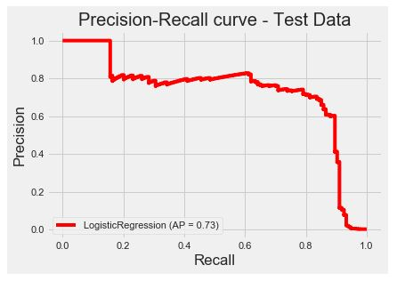
LR – Prediction & Model Performance
The performance metrics of LR for the training and test dataset are as follows.
The charts to the right to the show the Precision-Recall curve for the training and test data.
Model performance is quite different for the training and the test data.
The average precision is 5% lower for the test data versus the training data.
There suggests that the model is overfitting the training data.
LR | Training | Test
Precision | 0.91 | 0.76
Recall | 0.67 | 0.68
F-Measure | 0.77 | 0.72

Slide 22
LR – Pros and Cons
Pros
It requires very little computational power because of it’s efficient algorithm.
Does not require features to be scaled.
Cons
It is not able to handle large numbers of categorical variables.
It is vulnerable to overfitting.
Feature estimates are inaccurate if there is multicollinearity between the independent variables.

Slide 23
Naïve – Bayes Classifier

Slide 24
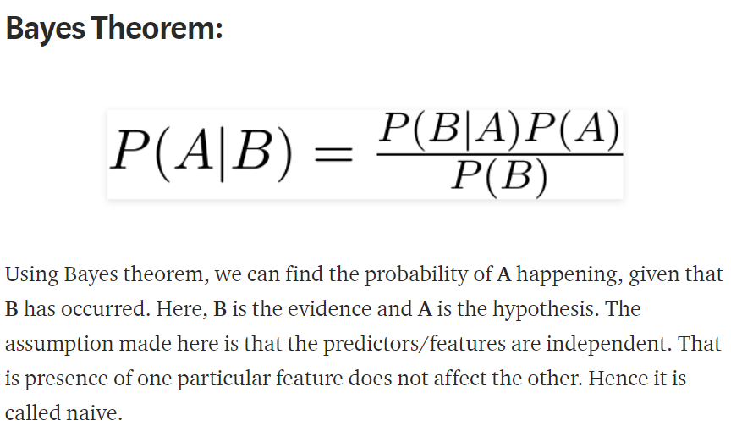
Naïve – Bayes Classifier
A Naive Bayes classifier is a probabilistic machine learning model that’s used for classification task. The crux of the classifier is based on the Bayes theorem.

Slide 25
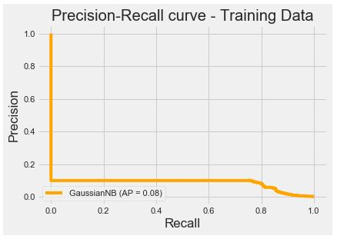
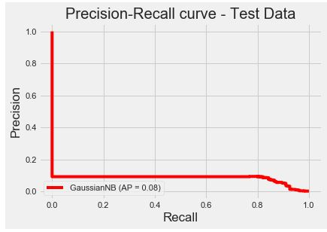
Naïve – Bayes Prediction & Model Performance
The performance metrics of NB for the training and test dataset are as follows.
The charts to the right to the show the Precision-Recall curve for the training and test data.
As you can see Naïve-Bayes classifier produces very low precision.

Slide 26
Naïve - Bayes – Pros and Cons
Pros
It is a relatively easy algorithm to build and understand.
It is faster to predict classes using this algorithm than many other classification algorithms.
It can be easily trained using a small data set.
Cons
If a given class and a feature have 0 frequency, then the conditional probability estimate for that category will come out as 0. This problem is known as the “Zero Conditional Probability Problem.” This is a problem because it wipes out all the information in other probabilities too. There are several sample correction techniques to fix this problem such as “Laplacian Correction.”
Another disadvantage is the very strong assumption of independence class features that it makes. It is near to impossible to find such data sets in real life.

Slide 27
Random Forest

Slide 28
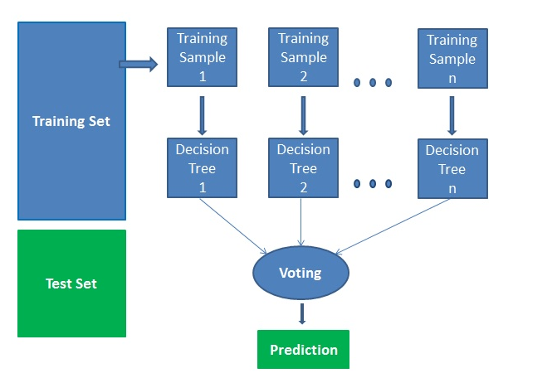
RF – Method
Random Forest is an ensemble method using multiple decision trees generated on a randomly split dataset.
In a classification problem, each tree votes and the most popular class is chosen as the result.
It is simpler and more powerful compared to the other non-linear classification algorithms.

Slide 29
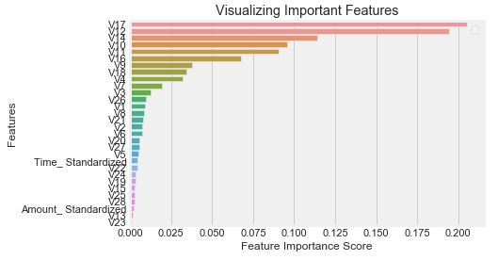
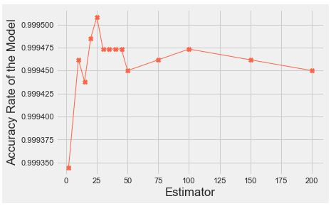
RF – Feature Selection
The first chart shows the important of the different features.
The second chart shows the change in accuracy based on the number of estimators used. We select 100 estimators as the accuracy flattens out after this point.

Slide 30
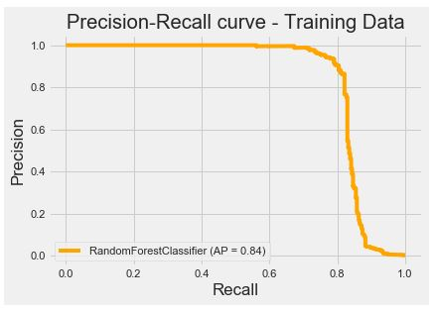
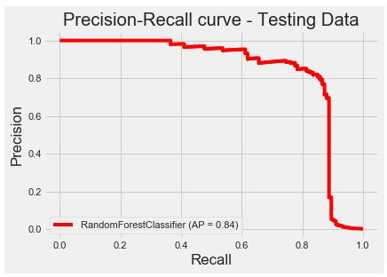
RF – Prediction & Model Performance
The performance metrics of RF for the training and test dataset are as follows.
The charts to the right to the show the Precision-Recall curve for the training and test data.
Model performance is similar for both the training and test data.
The average precision is 1% lower for the test data versus the training data.
There is no indication that the model is overfit the training data.
RF | Training | Test
Precision | 0.96 | 0.89
Recall | 0.73 | 0.75
F-Measure | 0.83 | 0.81

Slide 31
RF – Pros and Cons
Pros
Random forests is considered as a highly accurate and robust method because of the number of decision trees participating in the process.
It does not suffer from the overfitting problem. The main reason is that it takes the average of all the predictions, which cancels out the biases.
Radom Forest can also generate feature importance, which helps in selecting the most contributing features for classifier
Cons
Random forests is slow in generating predictions because it has multiple decision trees. Whenever it makes a prediction, all the trees in the forest have to make a prediction for the same given input and then perform voting on it. This whole process is time-consuming.
The model is difficult to interpret compared to a decision tree, where you can easily make a decision by following the path in the tree.

Slide 32
Model Comparison – Test Data

Slide 33
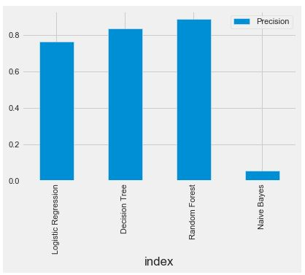
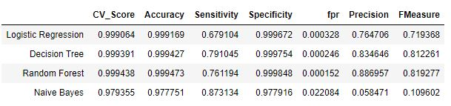
Model Selection
Based on our analysis the F-measure is 0.81 for Decision Tree and Random Forest suggesting that these are two best models.
However, model performance Decision Tree is quite different for the training and test data implying that the model is overfit.
The performance of Random Forest implies the model is more robust.
Based on this we recommend using Random Forest for predicting fraud for our dataset.

Slide 34
Limitations of our analysis
Cost Analysis
The costs each outcome (TP, TN, FP, FN) are quite different from each other.
If a merchant is responsible for managing fraud, the cost of a FN is almost 2.5 times the transaction, while the revenue from a true positive is equal to the margin of the transaction (normally in the 5—10% range)
The next step for our model would be to include a cost function and use that to select a threshold instead of precision-recall.
Oversampled data
Our literature survey for this project suggested that we should use oversampled data to build our model.
However, all our models performed poorly on the test data when we tried using oversampled data to train the model. We were unable to identify what’s causing this issue.
Resolving this issue could further improve our modelling accuracy.

Slide 35
Imbalanced data
A potential issue with imbalanced classification is that there may be too few examples of the minority class for a model to effectively learn the decision boundary.
One way to solve this problem is to oversample the examples in the minority class.
Most widely used approach to synthesizing new examples is called the Synthetic Minority Oversampling Technique, or SMOTE
SMOTE works by selecting examples that are close in the feature space, drawing a line between the examples in the feature space and drawing a new sample at a point along that line.
We can use SMOTE to oversample the fraud data.

